Slide 1

Data Communication and Computer Networks
3. Application Layer
PART-B
Dr. Aiman Hanna
Department of Computer Science & Software Engineering Concordia University, Montreal, Canada
These slides has mainly been extracted, modified and updated from original slides of : Computer Networking: A Top Down Approach, 6th edition Jim Kurose, Keith Ross Addison-Wesley, 2013
Additional materials have been extracted, modified and updated from: Understanding Communications and Networking, 3e by William A. Shay 2005
Copyright © 1996-2013 J.F Kurose and K.W. Ross
Copyright © 2005 William A. Shay
Copyright © 2018 Aiman Hanna All rights reserved
Application Layer B
2-‹#›

Slide 2
DNS: domain name system
Domain Name System:
1) distributed database implemented in hierarchy of many DNS servers
2) application-layer protocol: which allows hosts to query the database
name servers communicate to resolve names (address/name translation)
note: core Internet function, implemented as application-layer protocol
complexity at network’s “edge”; possibly a substantial delay
people: many identifiers:
SSN, name, passport #
Internet hosts, routers:
IP address (32 bit) - used for addressing datagrams
“name”, e.g., www.yahoo.com - used by humans
Q: how to map between IP address and name, and vice versa ?
Application Layer B
2-‹#›

Slide 3
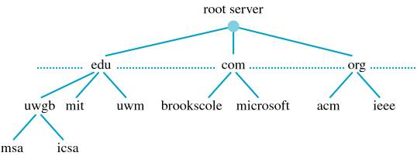
DNS: domain name system
To facilitate the lookup process, servers are organized into zones
A request for a textual name escalates, and may also go down, until the IP address is found (or the process fails)
why not centralize DNS?
Application Layer B
2-‹#›

Slide 4
DNS: services, structure
host aliasing: specify domain name as an alias of another
i.e. point ftp.example.com and www.example.com (an FTP server and a webserver running on two ports from a single IP address) to example.com
such domain names are referred to a Canonical Names (CNAMEs); the pointed-to domain name is an alias
a CNAME must point to another domain name; never to an IP address. In turn that pointed-to domain name points to the IP address
if the IP of the server ever changes, only one update to the DNS record is required for all CNAMEs
Application Layer B
2-‹#›

Slide 5
DNS: services, structure
mail server aliasing
e-mail addresses need to be resolved as well; however the name e-mail server may be CNAME
i.e. an e-mail directed to linda@example.com may seem to require resolving example.com; however the mail server at example.com may actually be a CNAME (i.e relay.west-coast.example.com)
DNS can be invoked by e-mail application to obtain the CNAME of an alias hostname, as well as the IP address of the host
Application Layer B
2-‹#›

Slide 6
DNS: services, structure
load distribution
heavy-loaded sites are often replicated over multiple servers
consequently, a set of IP addresses is associated with one hostname
DNS database contains the set of these IP addresses
the entire set is returned upon a query from a DNS client
client often sends its HTTP request to the first IP listed in the returned list
DNS rotations attempts to distribute the load over the replicated servers by rotating the order of the returned IP addresses
Application Layer B
2-‹#›

Slide 7
DNS: a distributed, hierarchical database
Root DNS Servers
…
…
com DNS servers
org DNS servers
edu DNS servers
yahoo.com
DNS servers
pbs.org
DNS servers
poly.edu
DNS servers
umass.edu
DNS servers
amazon.com
DNS servers
client wants IP for www.amazon.com; 1st approx:
client queries root server to find com DNS server
client queries .com DNS server to get amazon.com DNS server
client queries amazon.com DNS server to get IP address for www.amazon.com
Application Layer B
2-‹#›

Slide 8
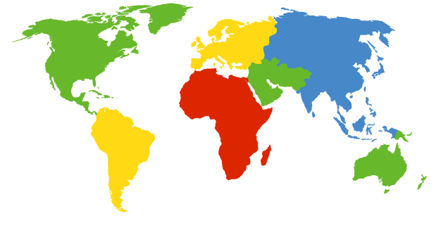
DNS: root name servers
contacted by local name server that can not resolve name
root name server:
contacts authoritative name server if name mapping not known
gets mapping
returns mapping to local name server
c. Cogent, Herndon, VA (5 other sites)
d. U Maryland College Park, MD
h. ARL Aberdeen, MD
j. Verisign, Dulles VA (69 other sites )
k. RIPE London (17 other sites)
i. Netnod, Stockholm (37 other sites)
e. NASA Mt View, CA
f. Internet Software C.
Palo Alto, CA (and 48 other sites)
m. WIDE Tokyo
(5 other sites)
13 root name “servers” worldwide (937 instances as of, September 19, 2018)
a. Verisign, Los Angeles CA
(5 other sites)
b. USC-ISI Marina del Rey, CA
l. ICANN Los Angeles, CA
(41 other sites)
g. US DoD Columbus, OH (5 other sites)
DNS root servers - 2012
Application Layer B
2-‹#›

Slide 9
TLD & authoritative servers
top-level domain (TLD) servers:
responsible for com, org, net, edu, aero, jobs, museums, and all top-level country domains, e.g.: uk, fr, ca, jp
Verisign/Network Solutions maintains servers for .com TLD
Educause for .edu TLD
authoritative DNS servers:
organization’s own DNS server(s), providing authoritative hostname to IP mappings for organization’s named hosts
can be maintained by organization or service provider
Application Layer B
2-‹#›

Slide 10
Local DNS name server
does not strictly belong to DNS hierarchy
each ISP (residential ISP, company, university) has one
also called “default name server”
when host makes DNS query, query is sent to its local DNS server
has local cache of recent name-to-address translation pairs (but may be out of date!)
acts as proxy, forwards query into hierarchy
Application Layer B
2-‹#›

Slide 11

DNS name resolution example
root DNS server
2
host at cis.poly.edu wants IP address for gaia.cs.umass.edu
3
TLD DNS server
4
5
Iterative query:
contacted server replies with name of server to contact
“I don’t know this name, but ask this server”
Note: call from cis.poly.edu is recursive; rest are iterative
local DNS server
dns.poly.edu
7
6
1
8
authoritative DNS server
dns.cs.umass.edu
requesting host
cis.poly.edu
gaia.cs.umass.edu
Application Layer B
2-‹#›

Slide 12
DNS name resolution example
root DNS server
2
3
recursive query:
puts burden of name resolution on contacted name server
heavy load at upper levels of hierarchy?
7
6
TLD DNS
server
local DNS server
dns.poly.edu
5
4
1
8
authoritative DNS server
dns.cs.umass.edu
requesting host
cis.poly.edu
gaia.cs.umass.edu
Application Layer B
2-‹#›

Slide 13
DNS: caching, updating records
a critically important feature of DNS
improve delay performance & reduce DNS messages in the Internet
once (any) name server learns of an address mapping, it caches it
cache entries timeout (disappear) after some time (TTL)
TLD servers typically cached in local name servers
thus root name servers not often visited
Application Layer B
2-‹#›

Slide 14
DNS: caching, updating records
cached entries may be out-of-date (best effort name-to-address translation!)
if name host changes IP address, may not be known Internet-wide until all TTLs expire
update/notify mechanisms proposed IETF standard
RFC 2136
Application Layer B
2-‹#›

Slide 15
DNS records
DNS: distributed db storing resource records (RRs)
RR format: (Name, Value, Type, TTL)
type=A
name is hostname (e.g, relay.west-coast.example.com)
value is IP address
Example: (relay1.bar.foo.com, 145.46.93.9, A)
type=CNAME
name is alias name for some “canonical” (the real) name
www.ibm.com is really
servereast.backup2.ibm.com
value is the canonical name
Example: (foo.com, relay1.bar.foo.com, CNAME)
type=NS
name is domain (e.g., foo.com)
value is hostname of authoritative name server for this domain
Example: (foo.com, dns.foo.com, NS)
type=MX
name is an alias host name
value is a canonical name of mailserver associated with name
Example: (foo.com, mail.bar.foo.com, MX)
Application Layer B
2-‹#›

Slide 16
DNS records
each DNS reply may carry one or more RRs
Example
Assume the DNS server is an authoritative server for a particular hostname
server will return Type A RR e.g., (gaia.cs.umass.edu, 145.119.96.44, A)
Note: This type may be returned by any non-authoritative server as well (i.e. from a previously cashed record)
Assume the DNS server is NOT an authoritative server for a particular hostname
server may return Type NS RR e.g., (umass.edu, dns.umass.edu , NS)
As well as:
e.g., (dns.umass.edu, 145.119.96.28, A)
Application Layer B
2-‹#›

Slide 17
DNS protocol, messages
query and reply messages, both have same message format
2 bytes
2 bytes
msg header
identification: 16 bit # for query, reply to query uses same #
flags:
1-bit query or reply
1-bit recursion desired
1-bit recursion available
1-bit reply is authoritative
identification
flags
# questions
# answer RRs
# authority RRs
# additional RRs
questions (variable # of questions)
answers (variable # of RRs)
authority (variable # of RRs)
additional info (variable # of RRs)
Application Layer B
2-‹#›

Slide 18
DNS protocol, messages
name, type fields for a query
i.e. host address associated with a name (type A), or the mail server for a name (type MX)
2 bytes
2 bytes
RRs in response
to query
P/S: A reply may contain multiple RRs (i.e. for replicated web servers)
identification
flags
# questions
# answer RRs
# authority RRs
# additional RRs
records for
authoritative servers
questions (variable # of questions)
additional “helpful”
info that may be used
i.e. the answers section of a reply to an MX query include a RR providing the CNAME of the mail server. In the additional section may contain a type A RR providing the IP address of this CNAME
answers (variable # of RRs)
authority (variable # of RRs)
additional info (variable # of RRs)
Application Layer B
2-‹#›

Slide 19
Inserting records into DNS
example: new startup “Network Utopia”
register name networkuptopia.com at DNS registrar (e.g., Network Solutions)
provide names, IP addresses of authoritative name server (primary and secondary)
registrar inserts two RRs into .com TLD server: (networkutopia.com, dns1.networkutopia.com, NS)
(dns1.networkutopia.com, 212.212.212.1, A)
enter needed records into your authoritative DNS server:
type A record for www.networkuptopia.com;
type MX record for mail.networkutopia.com
Application Layer B
2-‹#›

Slide 20
Attacking DNS
DDoS attacks
Bombard root servers with traffic
i.e. large-scale attack on October 21, 2002 using massive ping messages to the 13 root servers
Not successful to date
Traffic Filtering (configured to block ping messages)
Local DNS servers cache IPs of TLD servers, allowing root server bypass
Bombard TLD servers
Potentially more dangerous
i.e. send a massive number of DNS quires; which will not be filtered
Severity can still be mitigated (at least partially) by caching in local DNS servers
Application Layer B
2-‹#›

Slide 21
Attacking DNS
Redirect attacks
Man-in-middle
Intercept queries, then send bogus replies
DNS poisoning
Send bogus replies to DNS server, which caches these incorrect replies
Connections to the intended site can then be directed to the attacker’s site
Exploit DNS for DDoS (not directly an attack on DNS but on a targeted host)
Send queries to many authoritative DNS servers with spoofed source address as target IP
Requires amplification (responses are much larger than queries), which overwhelm the target
Notice that this is done without the need for the attacker to generate much of its own traffic
Application Layer B
2-‹#›

Slide 22

















Pure P2P architecture
no always-on server
arbitrary end systems directly communicate
peers are intermittently connected and change IP addresses
examples:
file distribution (BitTorrent)
Streaming (KanKan)
Application Layer B
2-‹#›

Slide 23
File distribution: client-server vs P2P
Question: how much time to distribute file (size F) from one server to N peers (clients)?
peer upload/download capacity is limited resource
u_{s}: server upload capacity
u₁
d_{i}: peer i download capacity
file, size F
u_{s}
d₁
u₂
d₂
server
d_{i}
u_{N}
network (with abundant
bandwidth)
u_{i}
d_{N}
u_{i}: peer i upload capacity
Application Layer B
2-‹#›

Slide 24
File distribution time: client-server
server transmission: must sequentially send (upload) N file copies:
total transmission: FN bits
time to send one copy: F/u_{s}
time to send N copies is: NF/u_{s}
➔ distribution time is, at least: NF/u_{s}
F
u_{s}
d_{i}
network
u_{i}
client: each client must download file copy
Let d_{min} denote the download rate of the peer with the slowest download rate
d_{min} = min{d₁, d₂, …, d_{N}}
min-client download time: F/d_{min}
➔ distribution time is, at least: F/d_{min}
Application Layer B
2-‹#›

Slide 25
File distribution time: client-server
➔ To send, distribution time is, at least: NF/u_{s}
➔ To receive, distribution time is, at least: F/d_{min}
Let D_{cs} denote distribution for client-server architecture
F
u_{s}
d_{i}
network
u_{i}
D_{cs} >= max{ NF/u_{s,}, F/d_{min} }
increases linearly in N
D_{cs} = max{ NF/u_{s,}, F/d_{min} }
Lower-bound (best case) distribution time
Application Layer B
2-‹#›

Slide 26
File distribution time: P2P
each peer can assist the server in distributing the file
server transmission: must upload at least one copy
➔ time to send one copy: F/u_{s}
F
u_{s}
d_{i}
network
u_{i}
client: each client must download file copy
min client download time: F/d_{min}
➔ distribution time is, at least: F/d_{min}
Total upload capacity of the system as a whole: u_{total =} u_{s} + u₁+ u₂ + u₃+ …. + u_{N}
System still needs to deliver F bits to N peers, totaling to NF bits, which cannot be done at a rate faster than u_{total}
➔ distribution time is, at least: NF/ u_{total}
Application Layer B
2-‹#›

Slide 27
File distribution time: P2P
➔ server time to send one copy: F/u_{s}
➔ client distribution time is, at least: F/d_{min}
➔ System-wide distribution time is, at least: NF/ u_{total}
F
u_{s}
d_{i}
network
u_{i}
Let D_{P2P} denote distribution for P2P architecture
_{N}
D_{P2P} >= max{ F/u_{s} , F/d_{min} ,NF/(u_{s} + Σu_{i}) }
_{i=1}
increases linearly in N …
… but so does this, as each peer brings service capacity
Application Layer B
2-‹#›

Slide 28
File distribution time: P2P
F
u_{s}
d_{i}
network
u_{i}
Lower-bound (actual minimum distribution time) for P2P distribution can then be given as:
_{N}
D_{P2P} = max{ F/u_{s} , F/d_{min} ,NF/(u_{s} + Σu_{i}) }
_{i=1}
Lower-bound (best case) distribution time
Application Layer B
2-‹#›

Slide 29
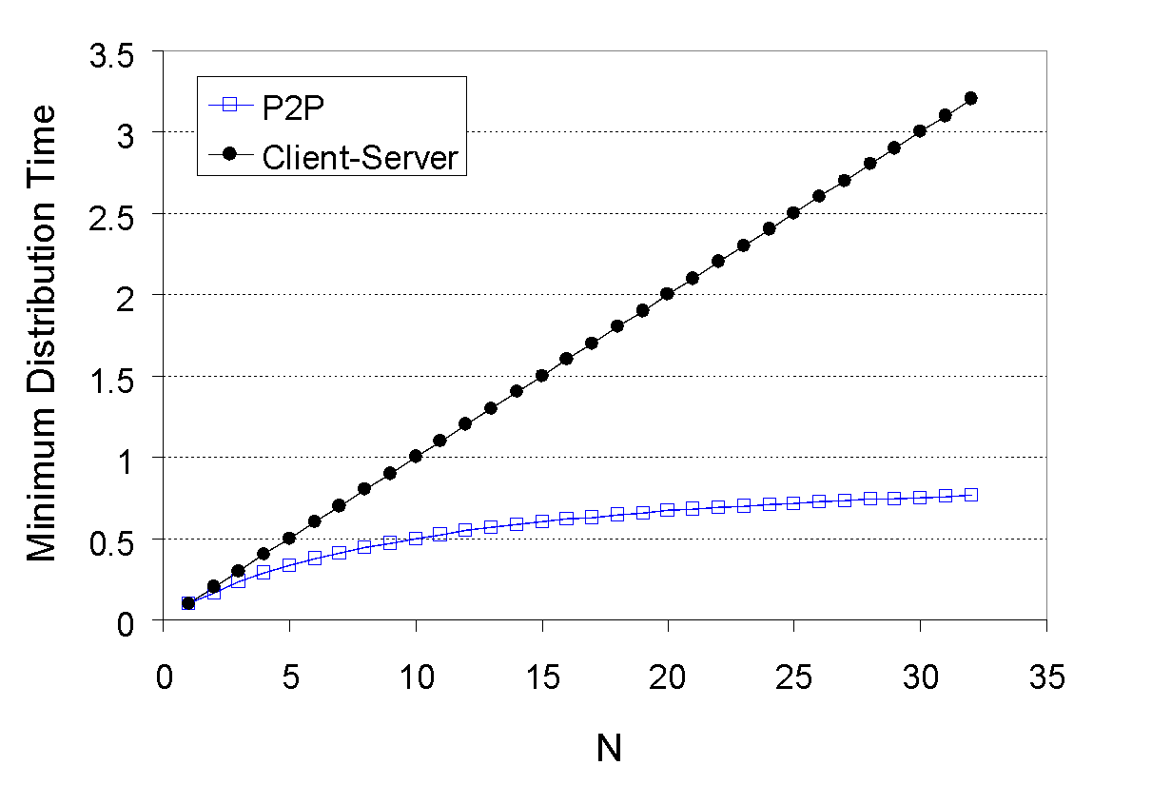
Client-server vs. P2P: example
client upload rate = u, F/u = 1 hour, u_{s} = 10u, d_{min} ≥ u_{s}
Application Layer B
2-‹#›

Slide 30


P2P file distribution: BitTorrent
file divided into 256KByte chunks
peers in torrent send/receive file chunks
torrent: group of peers participating in the distribution (exchanging chunks of a file)
tracker: tracks peers
participating in torrent
Alice arrives …
… obtains list
of peers from tracker
… and begins exchanging
file chunks with peers in torrent
Application Layer B
2-‹#›

Slide 31


P2P file distribution: BitTorrent
peer joining torrent:
has no chunks, but will accumulate them over time from other peers
registers with tracker to get list of peers, connects to subset of peers (“neighbors”)
while downloading, peer uploads chunks to other peers
peer may change peers with whom it exchanges chunks
churn: peers may come and go
once peer has entire file, it may (selfishly) leave or (altruistically) remain in torrent
Application Layer B
2-‹#›

Slide 32
BitTorrent: requesting, sending file chunks
requesting chunks:
at any given time, different peers have different subsets of file chunks
periodically, Alice asks each peer for list of chunks that they have
The provided list from each of the peers allows Alice to make 2 important decisions:
which chunks should she request first (rarest first)
to which of her neighbors should she send requested chunks
sending chunks: tit-for-tat
Alice sends chunks to the four peers currently sending her chunks at highest rate
other peers are choked by Alice (do not receive chunks from her)
re-evaluate top 4 every10 secs
every 30 secs: randomly select another peer, starts sending chunks
“optimistically unchoke” this peer
newly chosen peer may join top 4
Application Layer B
2-‹#›

Slide 33

BitTorrent: tit-for-tat
(1) Alice “optimistically unchokes” Bob
(2) Alice becomes one of Bob’s top-four providers; Bob reciprocates
(3) Bob becomes one of Alice’s top-four providers
higher upload rate: find better trading partners, get file faster !
Application Layer B
2-‹#›

